Slide 1

WELCOME TO:
General Meeting
6 PM Tuesday, October 16th, 2018
Broun Hall, Room 125

Slide 2
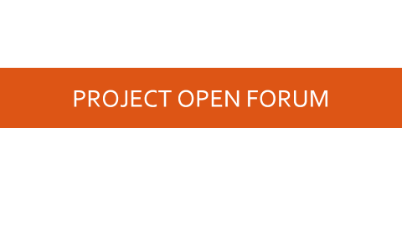
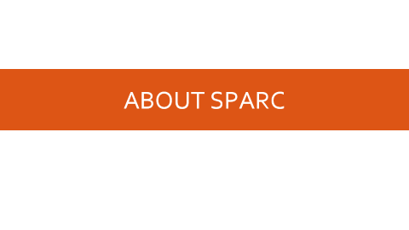
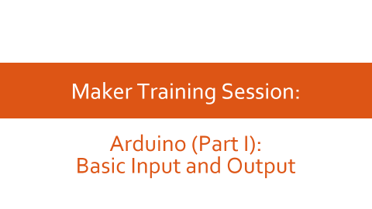
AGENDA

Slide 3
ABOUT SPARC

Slide 4
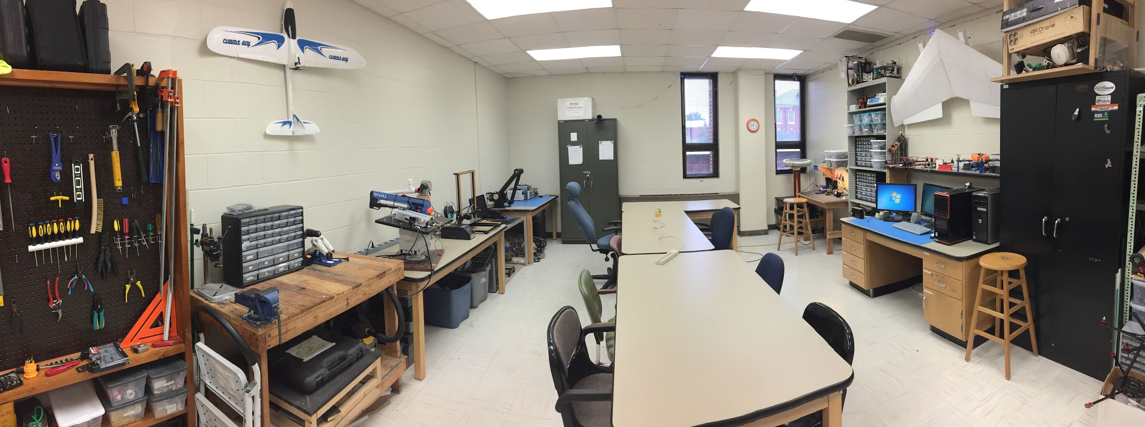
ABOUT SPARC
Creates and fosters an environment of creativity and innovation through collaborative projects.
A place to test out ideas, integrate concepts learned in class, and learn skills that will be instrumental when working in the workforce.
No prior experience is required, only a willingness to learn.
Lab:
- Broun 367
General Meetings:
- Tuesdays @ 6 in Broun 125
Project Meetings:
- Various Times during week

Slide 5
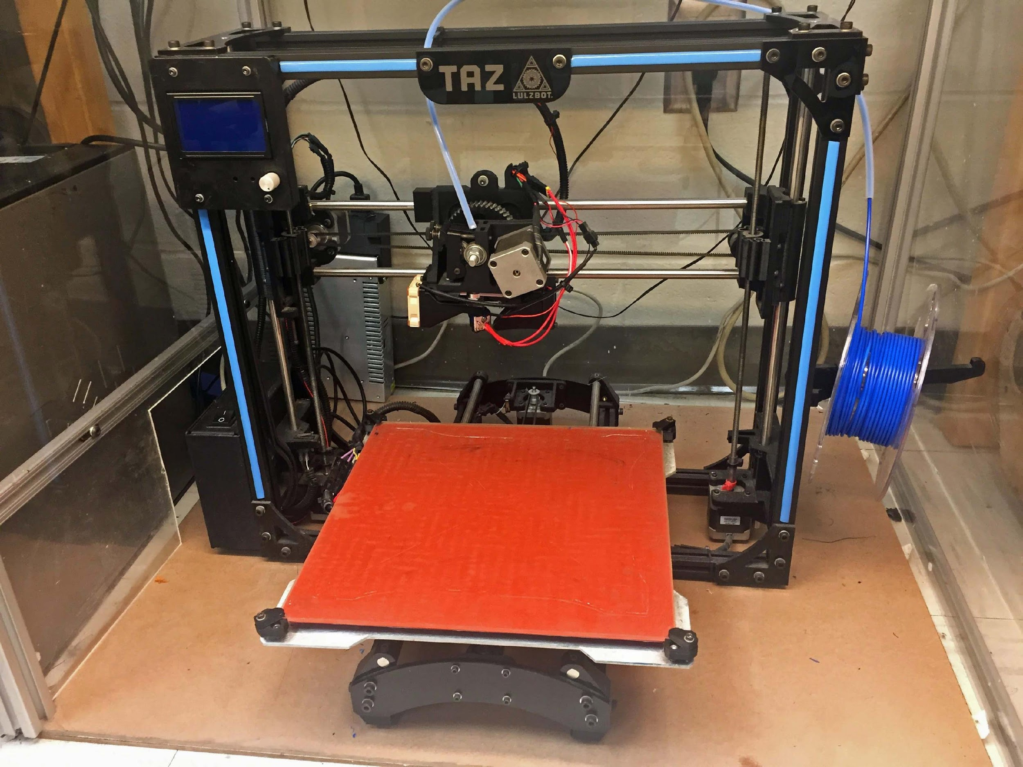
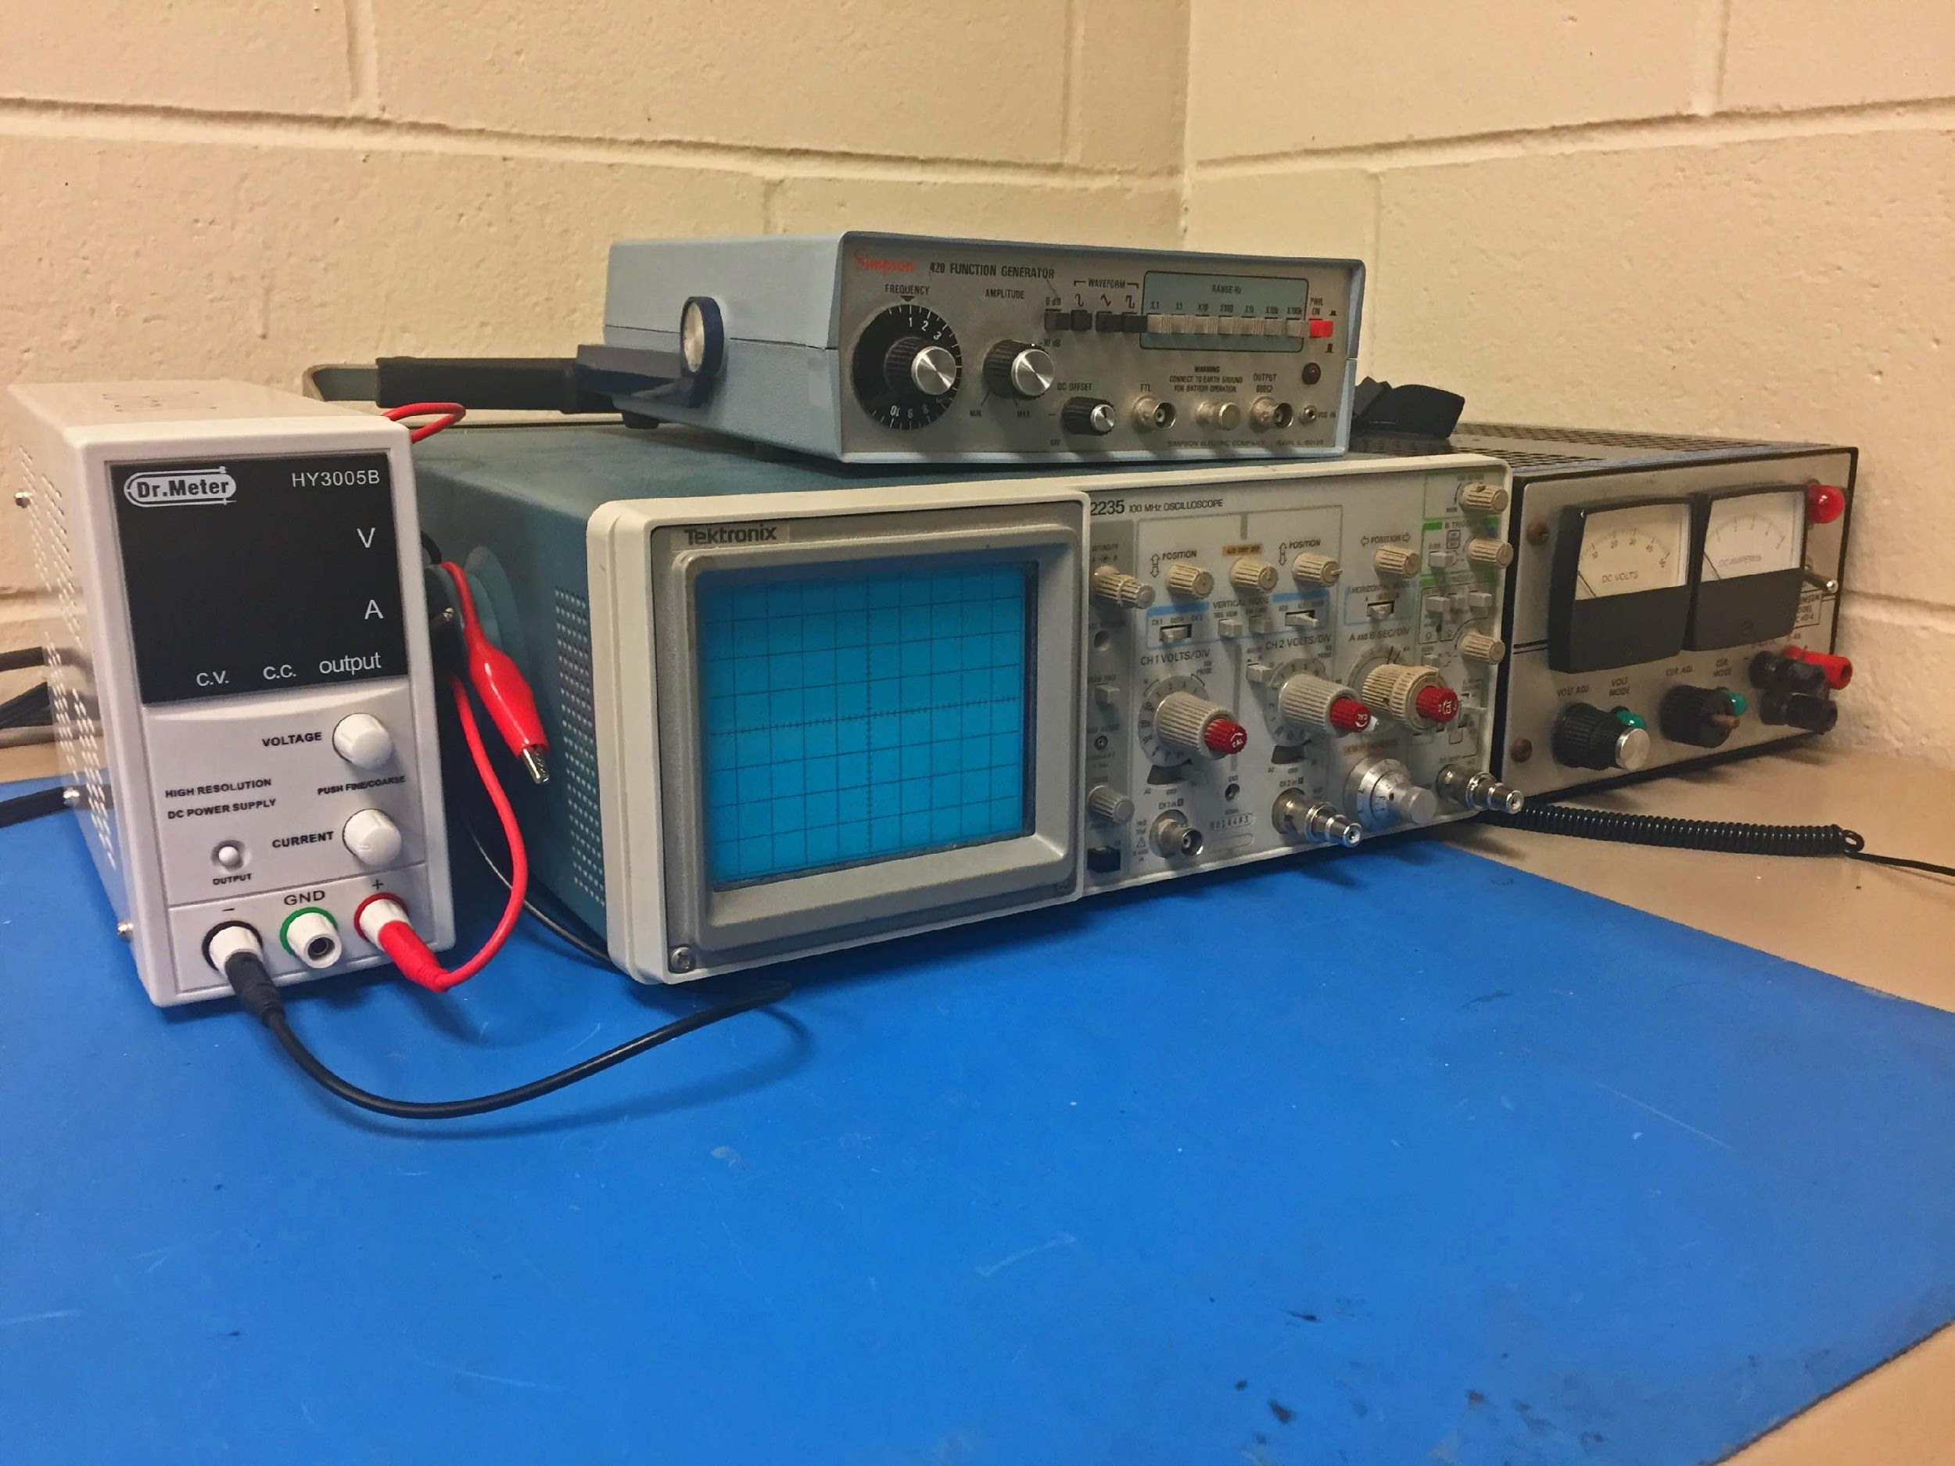
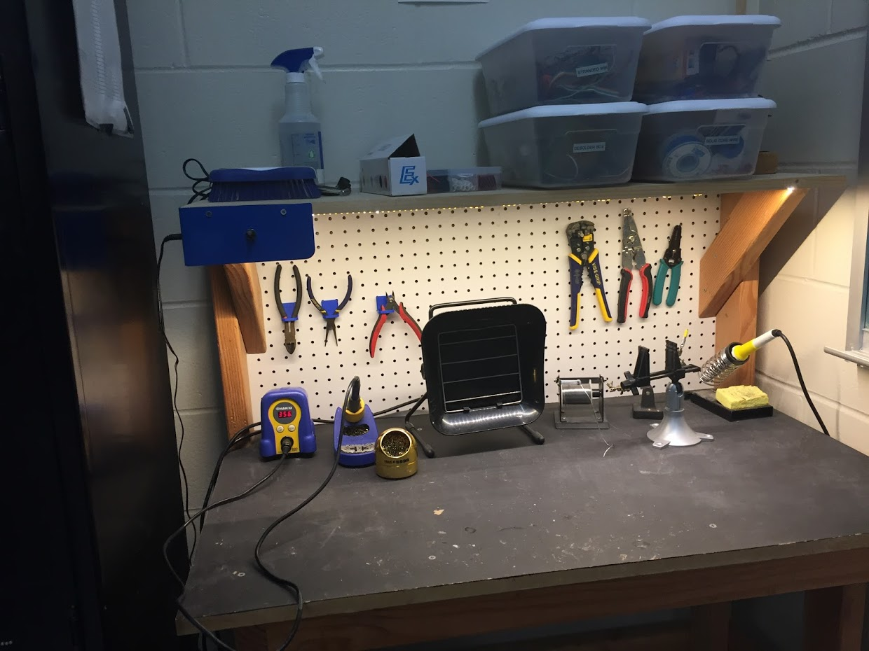
OUR LAB
Broun Hall
Room 367

Slide 6
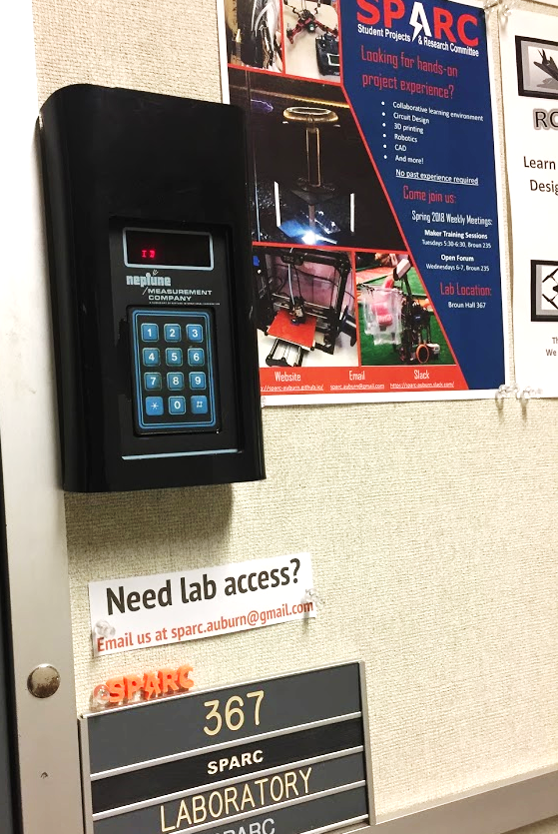
HOW TO BECOME A MEMBER
Log 5 constructive hours in the lab
Write the times on the sheet on the clipboard next to the door.
Contact us at sparc.auburn@gmail.com
We will respond with the instructions to get an access code.

Slide 7




MORE INFORMATION ABOUT SPARC
Website
http://sparc.eng.auburn.edu/
Github
https://github.com/SPARC-Auburn
Slack
https://sparc-auburn.slack.com/
Email
sparc.auburn@gmail.com

Slide 8
QUESTIONS?
Notes:
6:10

Slide 9
OUTREACH AND RECRUITMENT

Slide 10
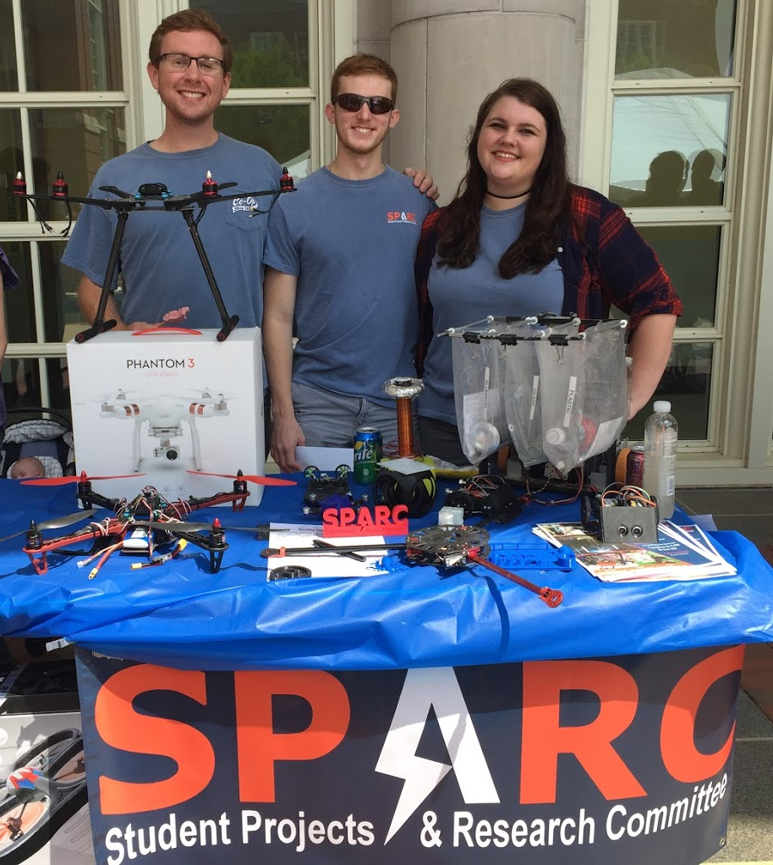
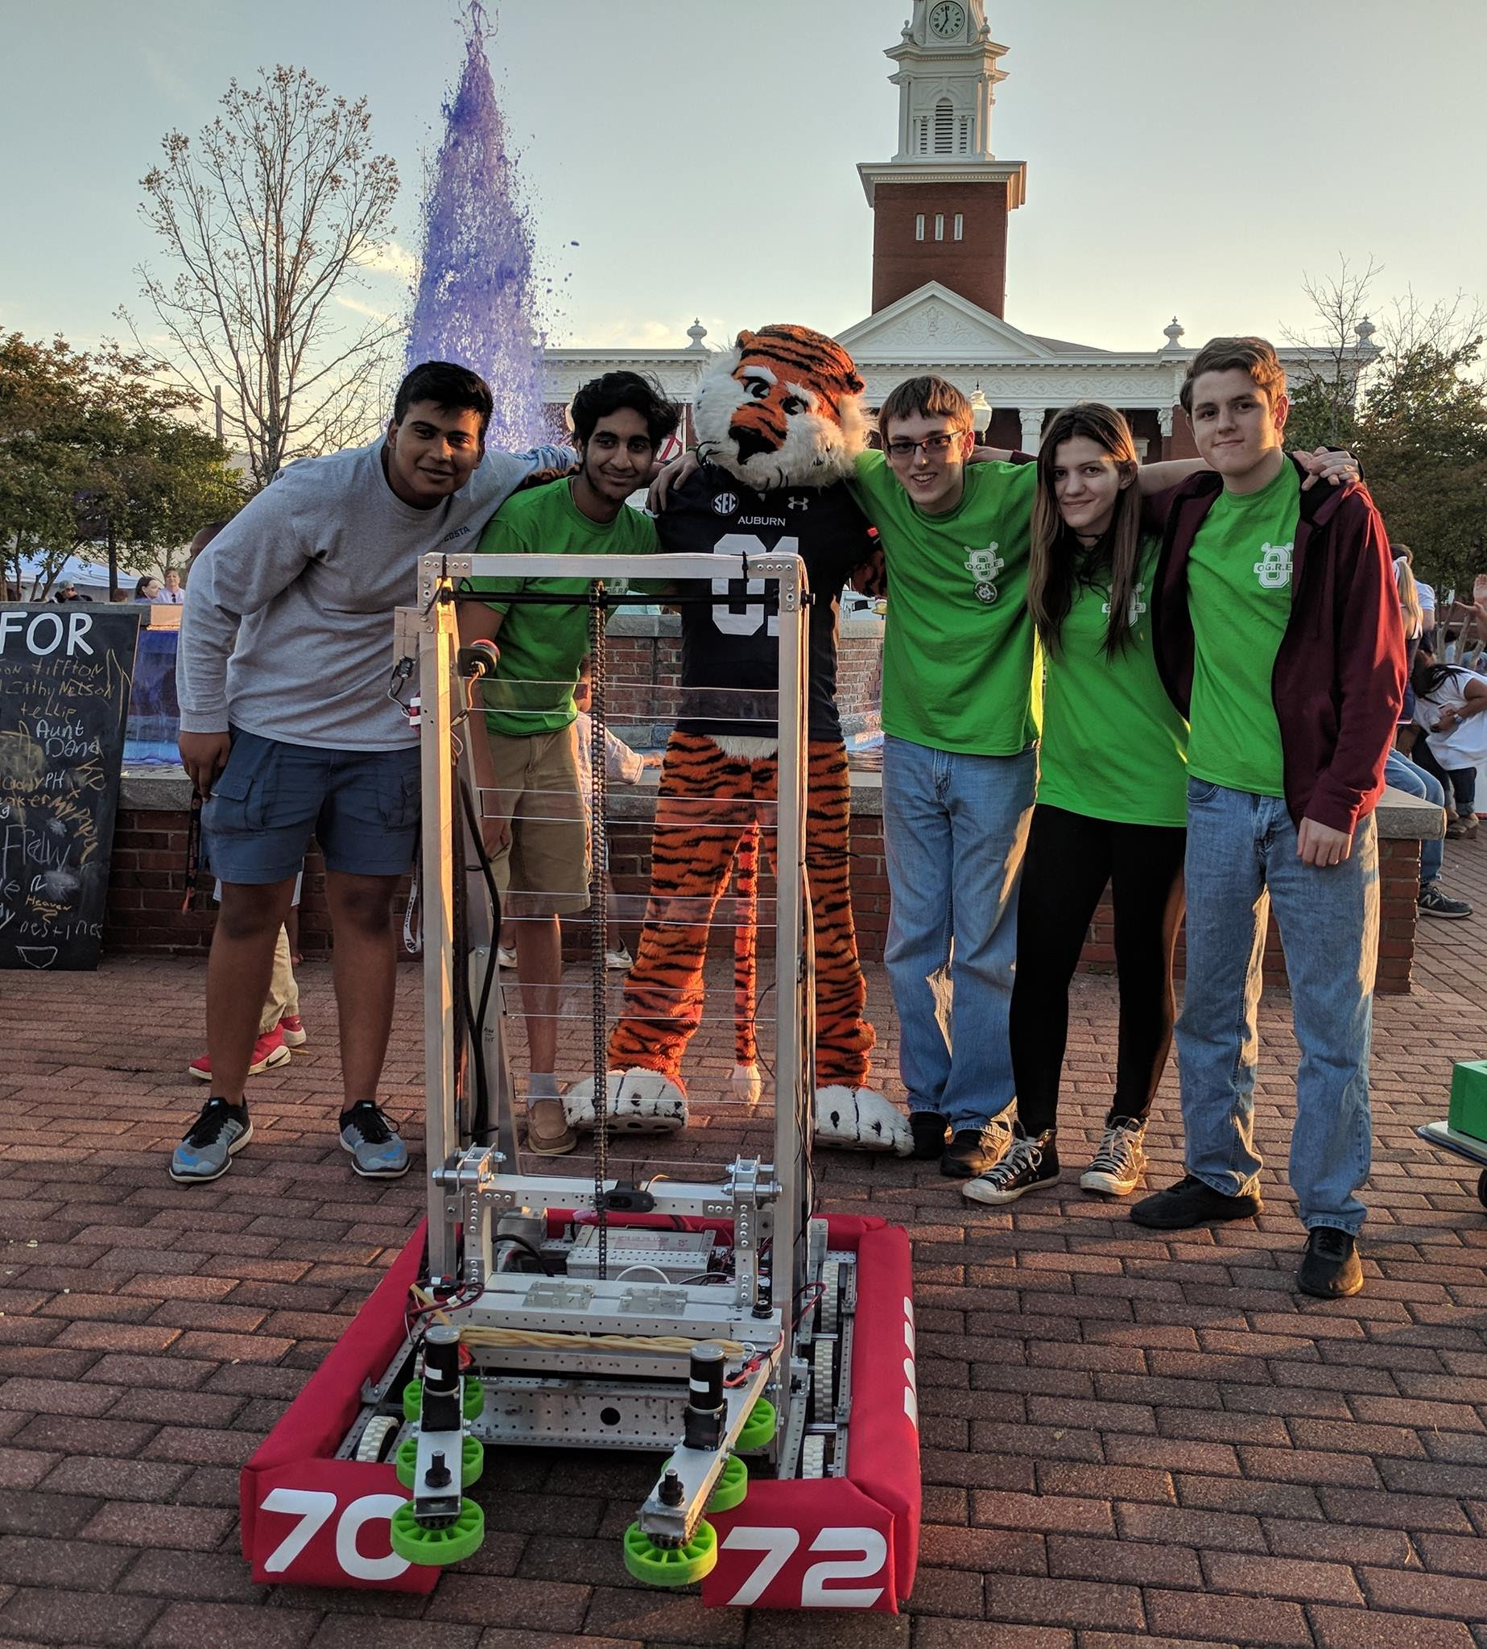
UPCOMING EVENTS
Opelika HS Robotics Team
Help mentor a local robotics team
Times: TWR: 3:30-6:30pm
Contact: Matthew Zacune <maz0006@auburn.edu>
Engineering BBQ 2018
FRC Team 7072 Bot
Notes:
Fall 2016
Loachapoka Robotics Mentoring- Mondays, Tuesdays, and Thursdays 3:00PM to 4:30PM
ECE Minority Presentation- November 14th
AJHS E-Day- November 17th
South’s Best- December 3-4th
SCORE Claw Machine- December 3-4th
Spring 2016
E-Day- Late February or early March
SPACE Day- Possible Event Next Semester
IEEE Sumo Robotics Competition (with local middle and high schools)- Spring 2017

Slide 11
PROJECT OPEN FORUM

Slide 12
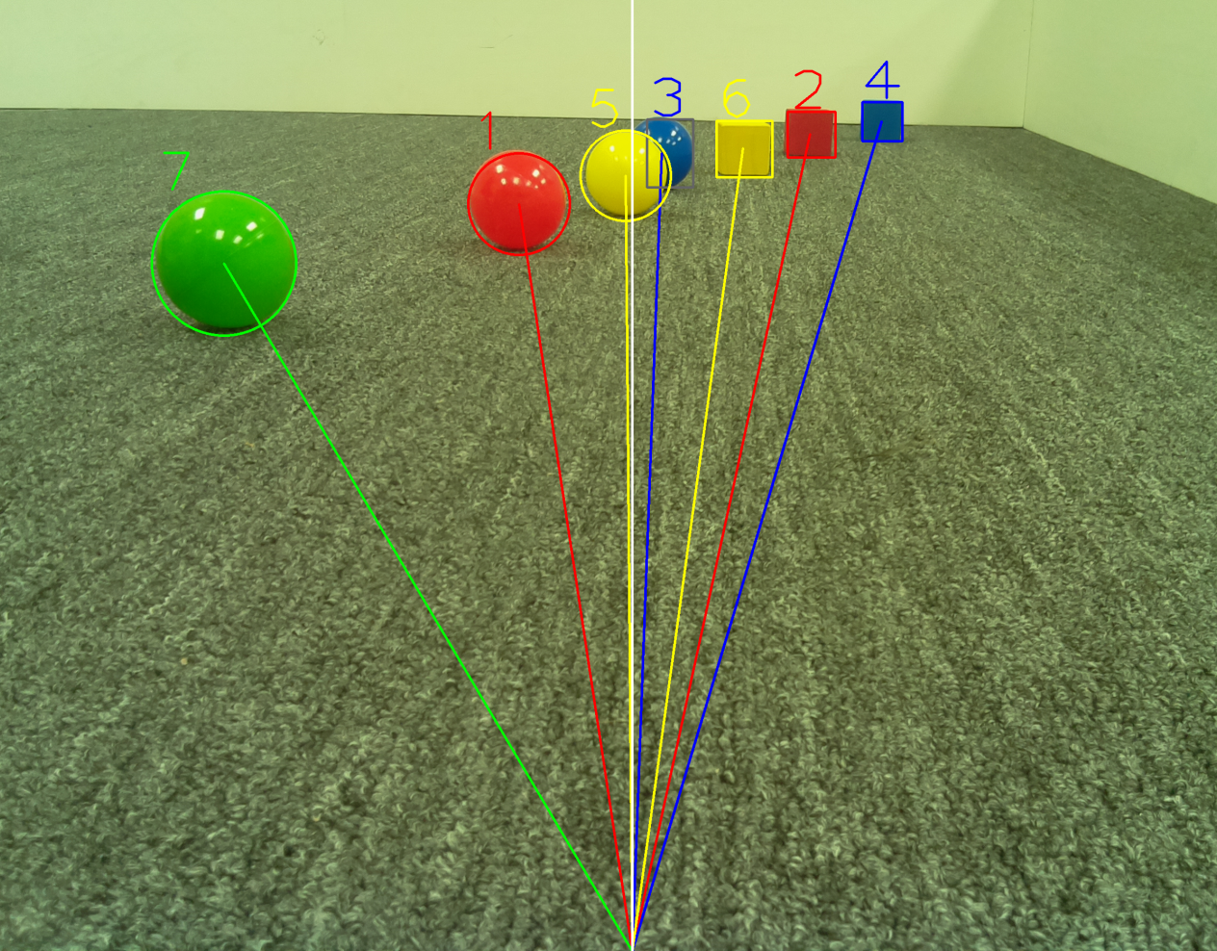
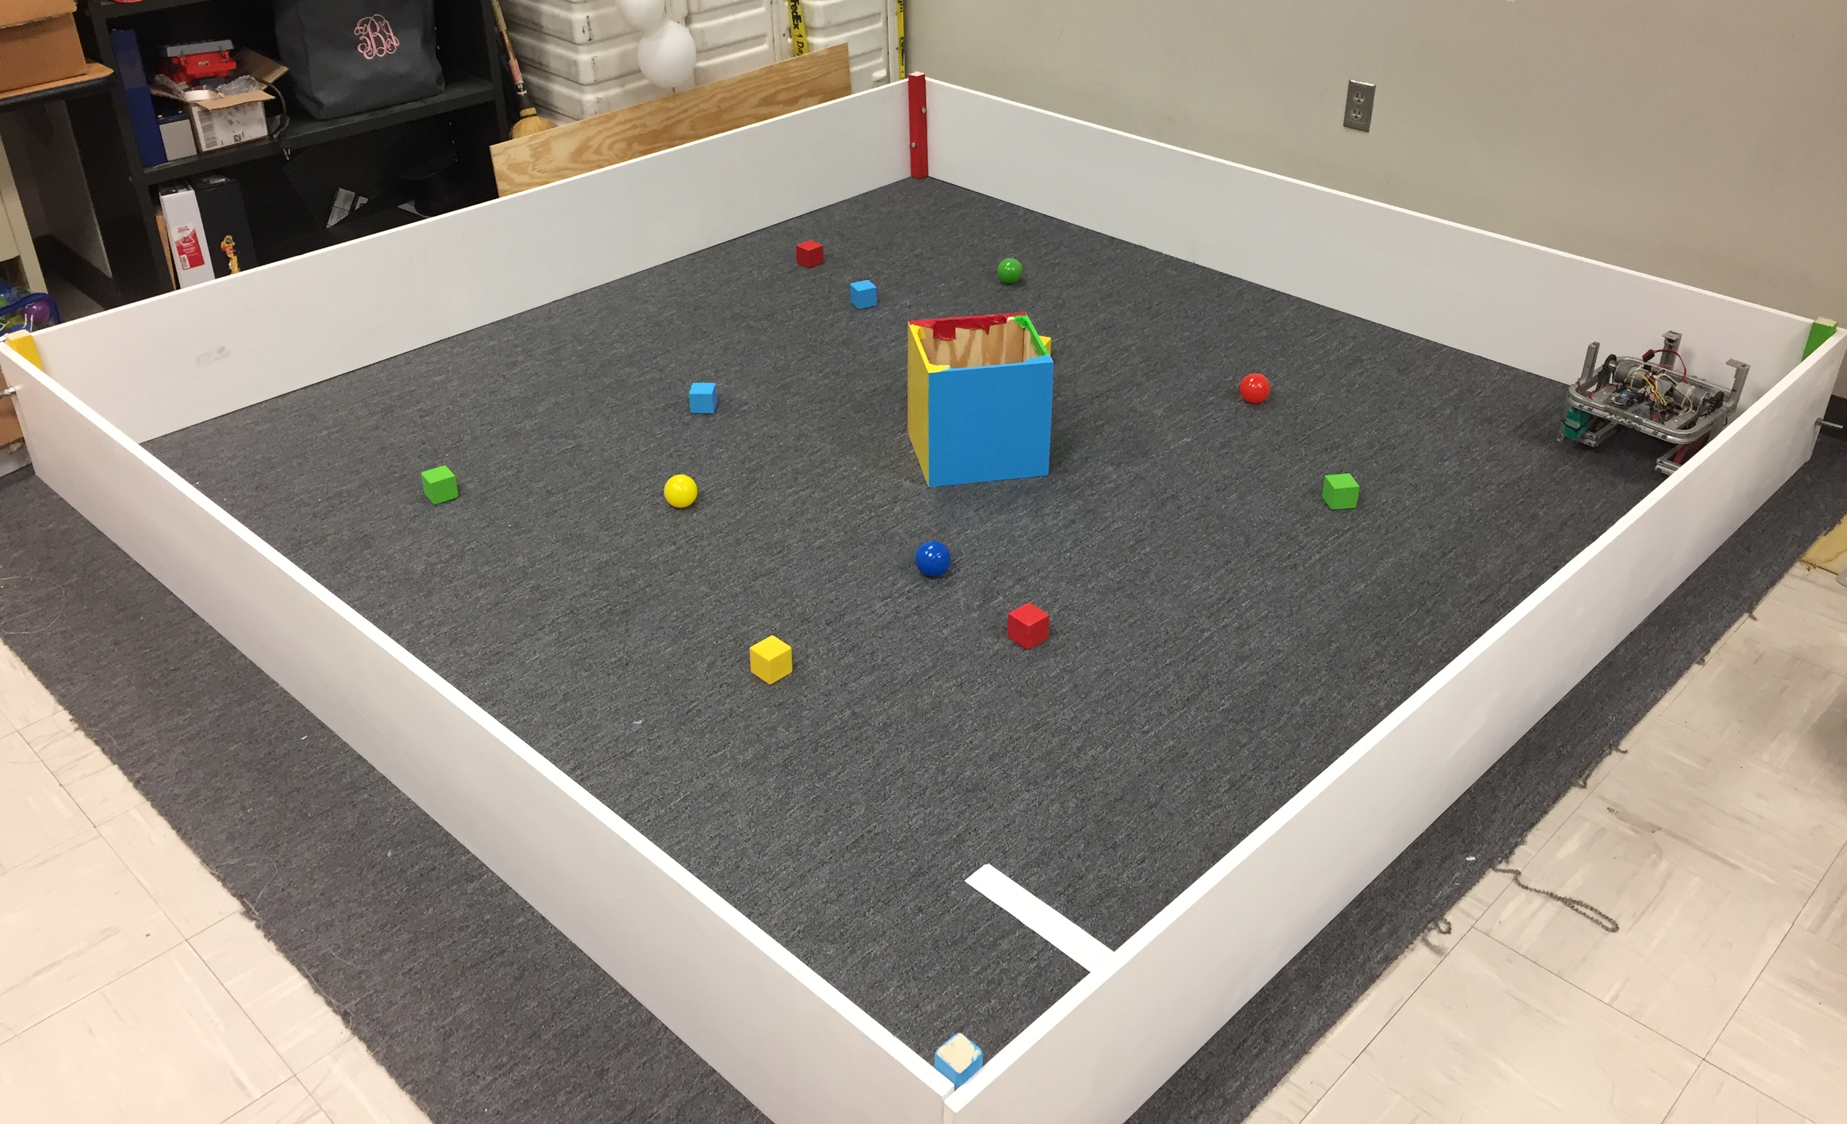
MAJOR PROJECT: IEEE SOUTHEAST CON
Project lead: Matthew Castleberry
Electrical lead: Josh Jablonowski
Mechanical lead: Alex Jones
Slack Channel: #projectieeeelectrical
Slack Channel: #projectieeemechanical
Competition Details:
Build a “space debris” collecting robot
Goal is to collect wood blocks and ball pit balls and deposit them on the side of a small flat ~100” square arena autonomously.
Max dimensions: 9” x 9” x 11”
When and Where:
Thursday, April 11th, 2019 through Sunday, April 14th, 2019.
IEEE Southeastcon conference in Huntsville, AL
Meeting Times
Electrical/Software Meeting: Tuesdays 12:30 - 2
Mechanical Meeting: Mondays 3 – 5
Programming Languages: C++,C
Gitlab: ask team lead for access

Slide 13
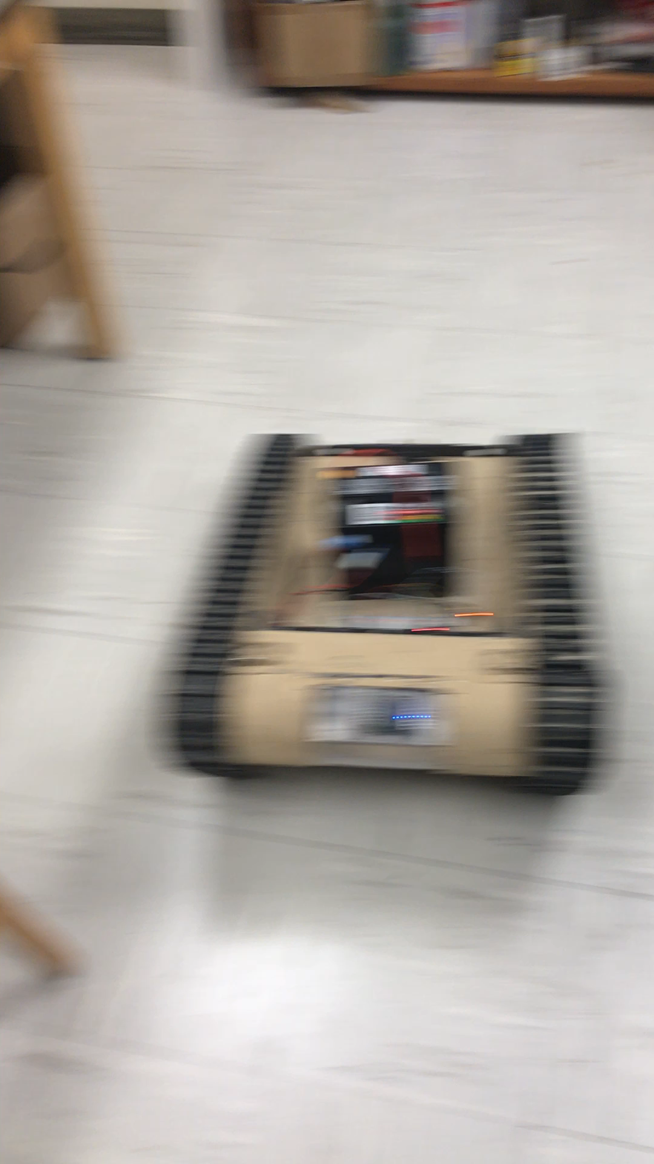
MAJOR PROJECT: MATILDA (Base)
Slack Channel: #projectmatildabase
Project lead: Ryan Moran
MATILDA stands for Mesa Associates' Tactical Integrated Light-Force Deployment Assembly
A bomb disposal robot from Dr. Roppel’s research lab.
Meeting Time:
Fridays 11:30 – 12:30
Semester Focus
Reestablishing mobility with wireless control
Establish autonomy with OpenCV
Potential add T-Shirt cannon to top
Github Repository
https://github.com/SPARC-Auburn/MATILDA-Base
Programming Languages
Python w/ OpenCV
C

Slide 14
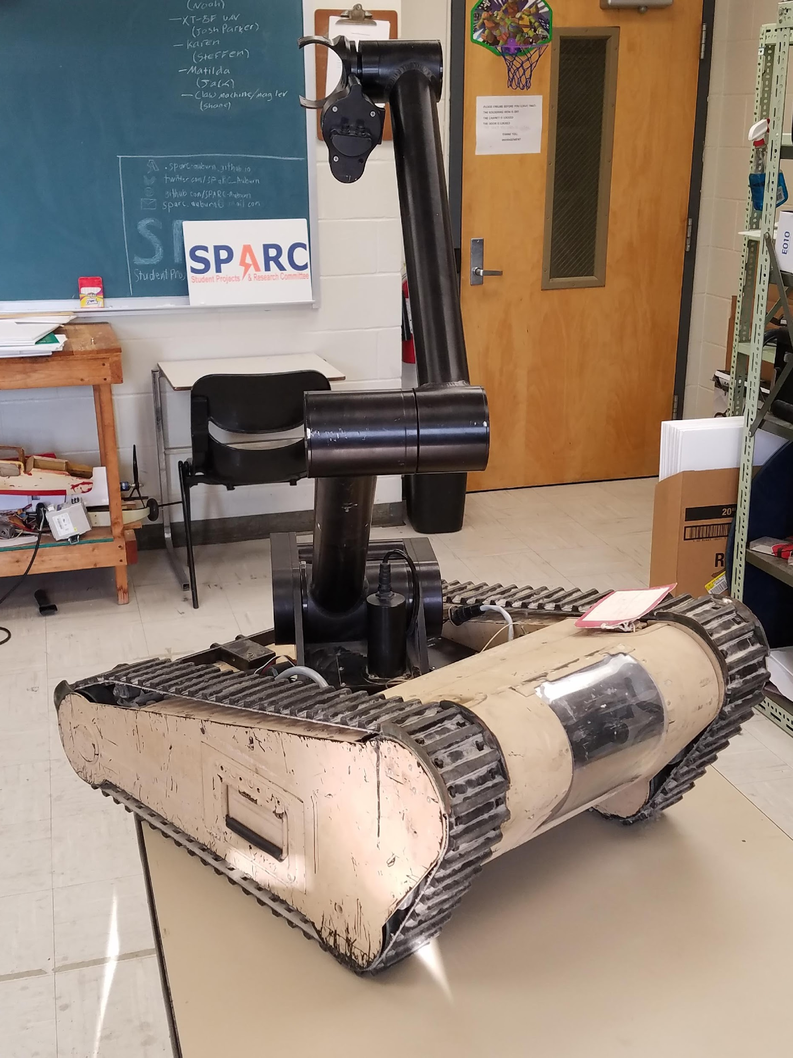
MAJOR PROJECT: MATILDA (Arm)
Slack Channel: #projectmatildarm
Project lead: Rice Shelley
MATILDA stands for Mesa Associates' Tactical Integrated Light-Force Deployment Assembly
A bomb disposal robot from Dr. Roppel’s research lab.
Meeting Times:
Thursdays 12:30 - 2
Semester Focus
Reestablishing arm control
Develop arm to play chess
Github Repository:
https://github.com/SPARC-Auburn/MATILDA-Arm
Programming Languages
Python w/ OpenCV
C

Slide 15
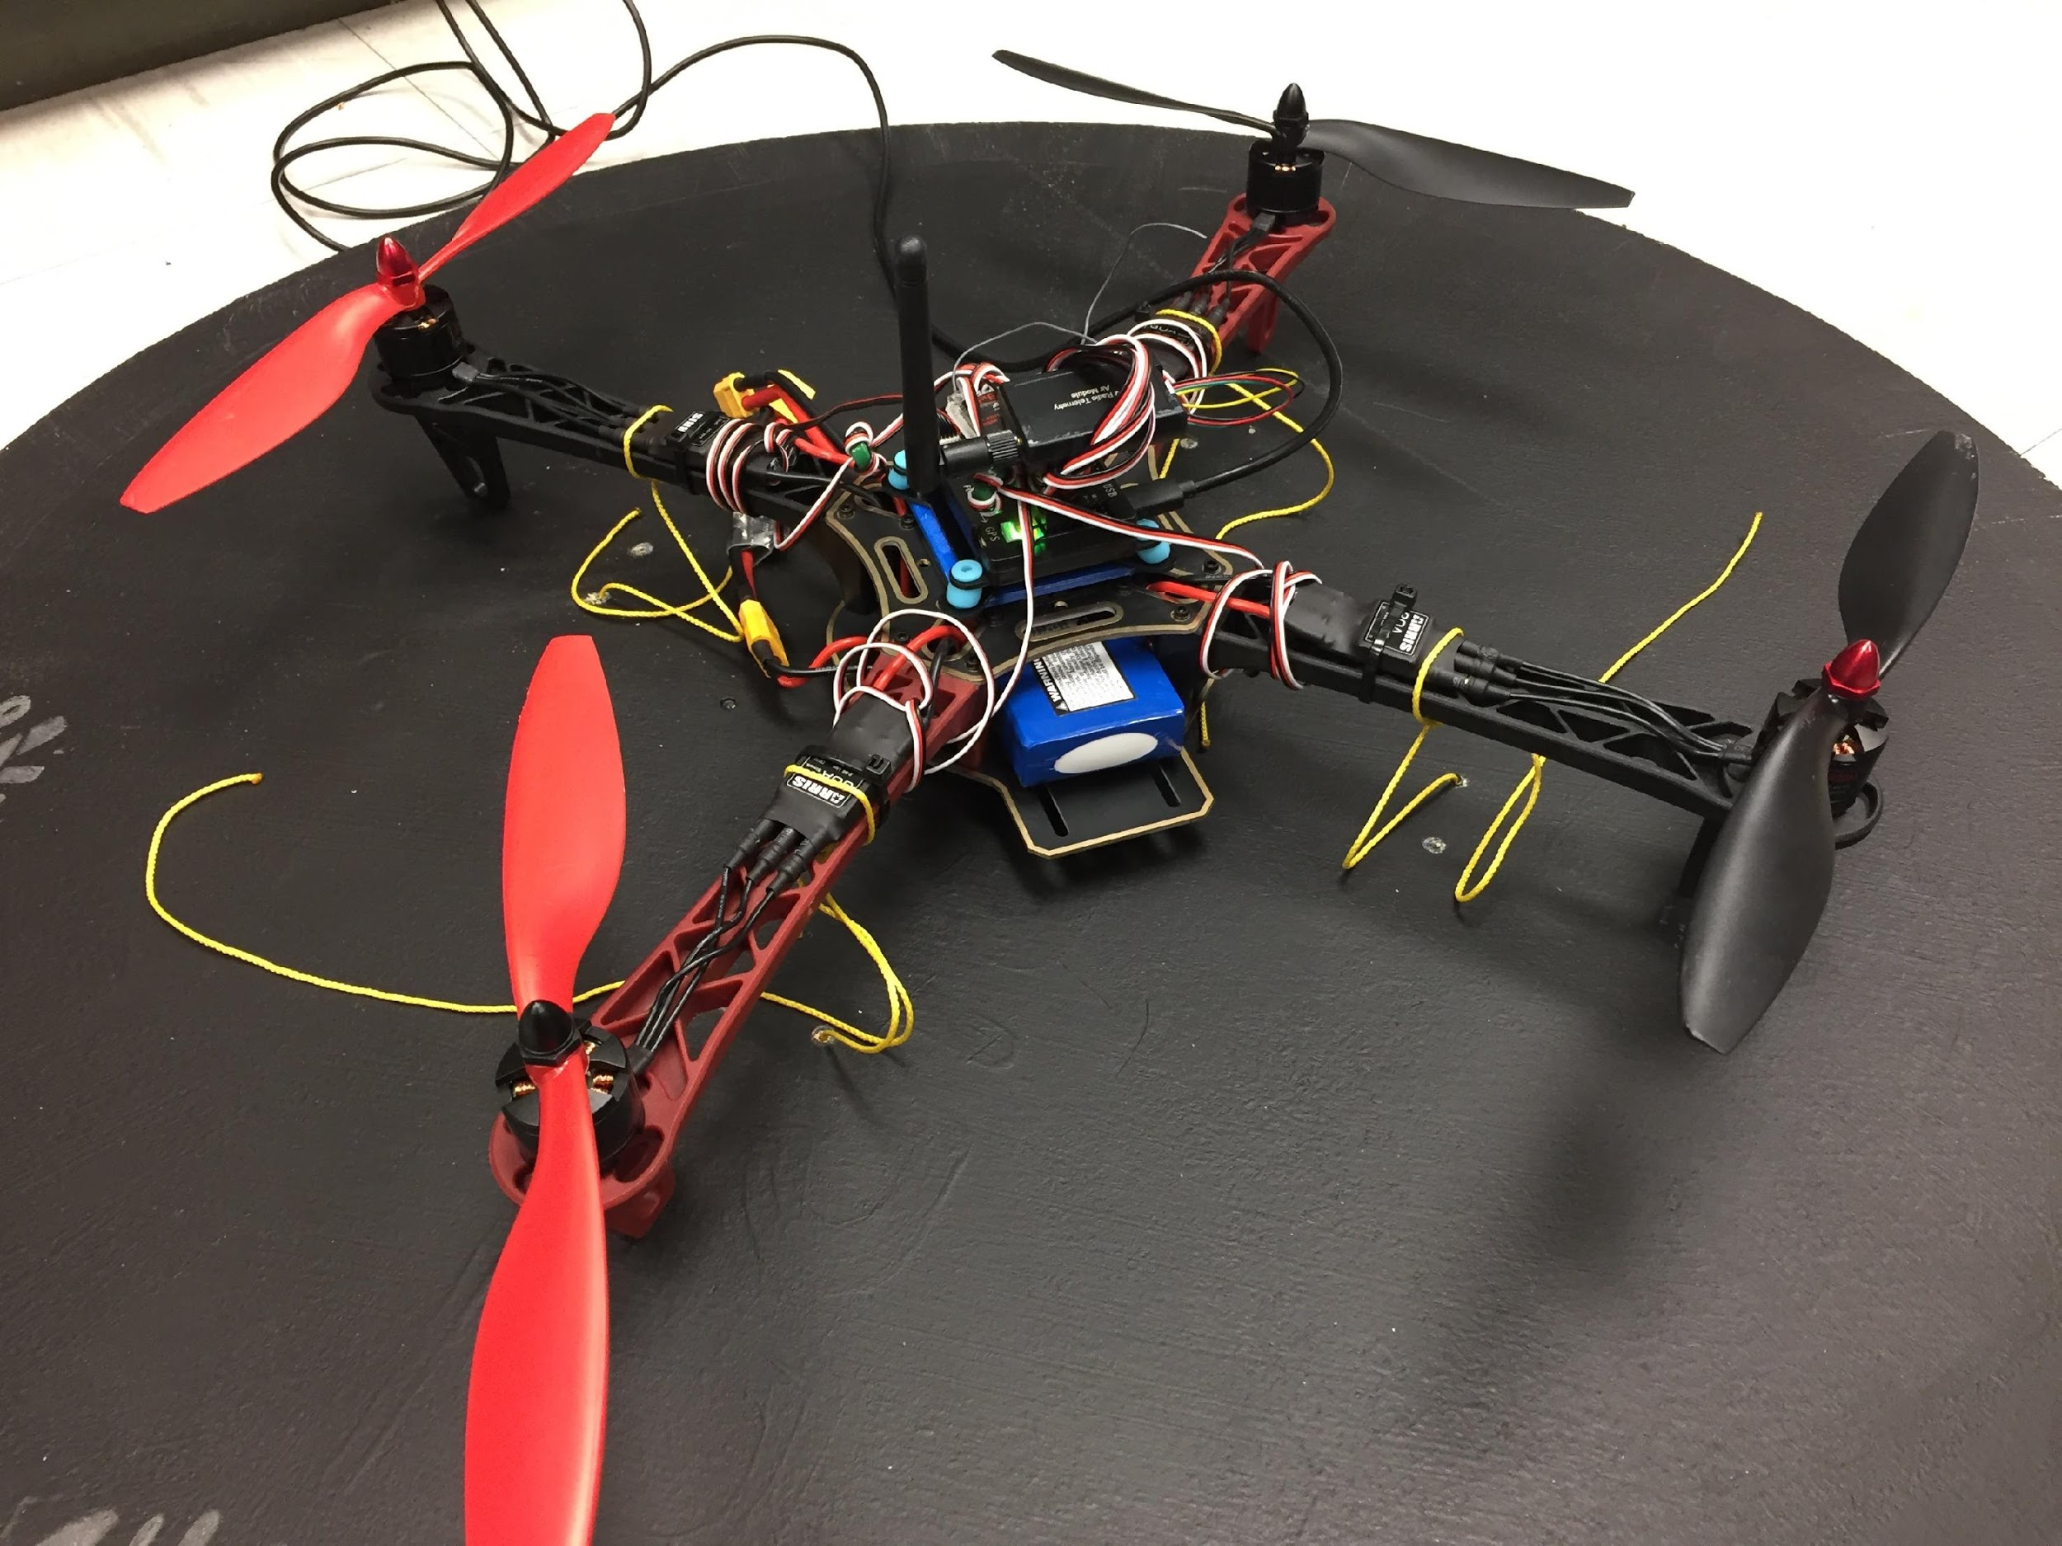
MAJOR PROJECT: MAIL BIRD
Project Lead: Joshua Parker
Slack Channel: #projectmailbird
Will be used to experiment with payload pickup, identification, and delivery
Partnership with RC Hobbyist Club
Semester Focus
Configure frame for waypoint navigation, etc.
Develop package release mechanism
Meeting Times
Wednesdays 11am – 1pm

Slide 16
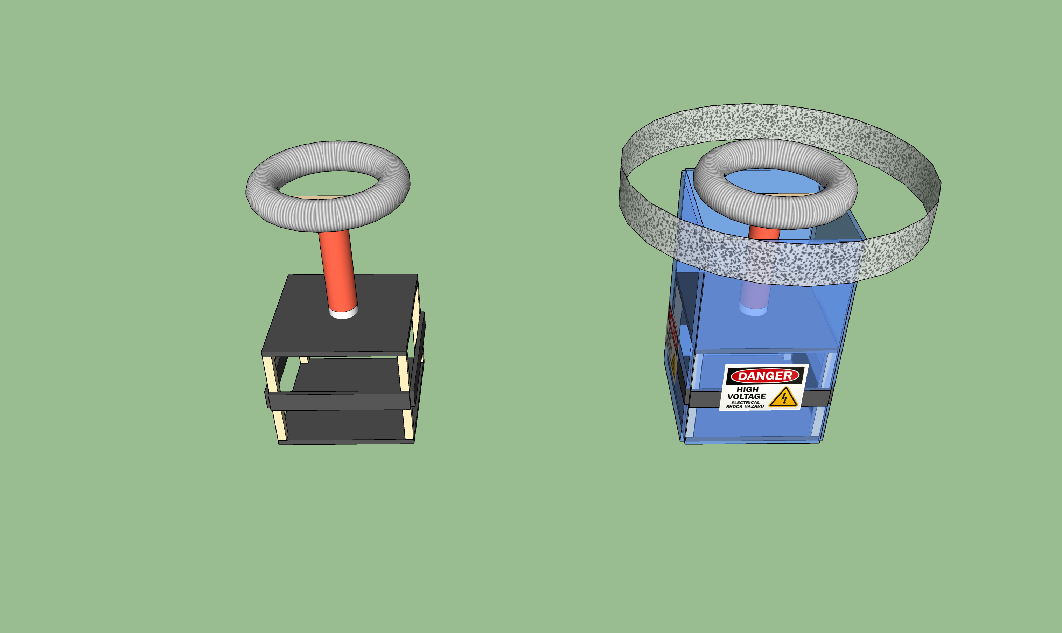
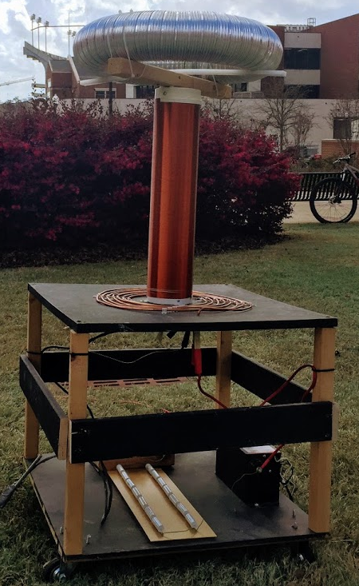
SIDE PROJECT: MUSICAL TESLA COIL
Project lead: Neil Postal
Slack Channel: #projectteslacoil
Demonstrated Tesla Coil at Spring 2016/18 E-Days
Currently uses spark gap style circuitry
Generated estimated 400,000 volts of electricity.
Semester Focus:
Increase safety precautions
Change from spark-gap design to solid-state design
Develop MIDI-input to allow music
Meeting times: Thursdays @ 3:30
Github: https://github.com/SPARC-Auburn/Tesla-Coil
Current Design
Possible safety precautions

Slide 17
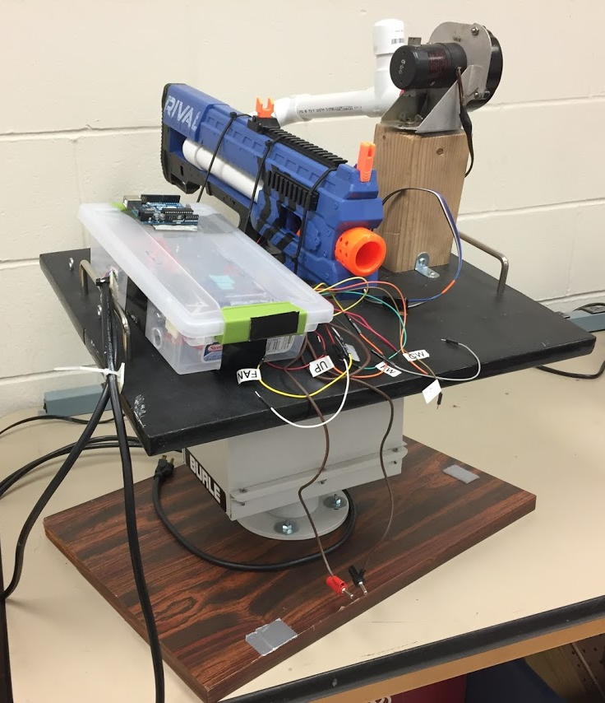
SIDE PROJECT: The Helpful Automated Defender (THAD)
Project lead: Josh Jablonowski
Slack Channel: #projectthad
Old project donated by EE department
It was demonstrated last spring at E-Day and PEAK.
Needs a new purpose to improve demonstrations
Github Repository:
https://github.com/SPARC-Auburn/THAD
Programming Languages
Python w/ OpenCV
C

Slide 18
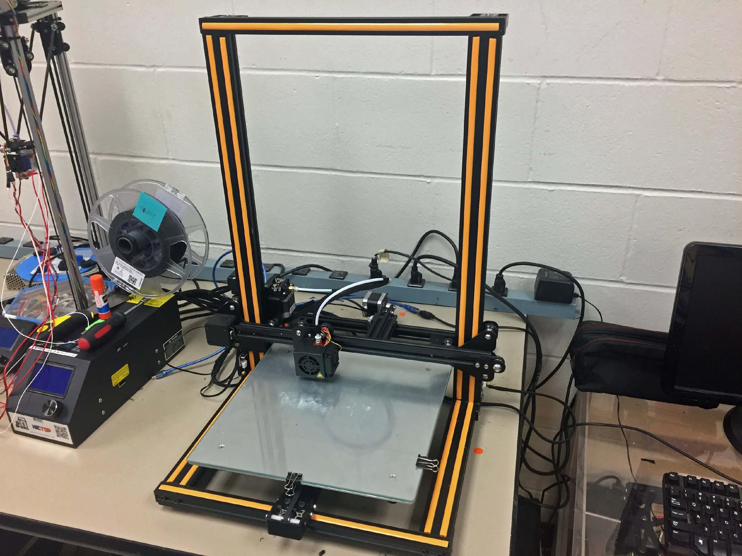
SIDE PROJECT: 3D PRINT ENCLOSURE
Project lead: Alex J. and Josh J.
Slack Channel: #3dprinting
Design double decker 3D printer enclosure to hold our Creality CR10 and Lulzbot Taz 3.
Will have wheels and have hinged doors
Will be a potential requirement based on new campus 3D printing rules.

Slide 19
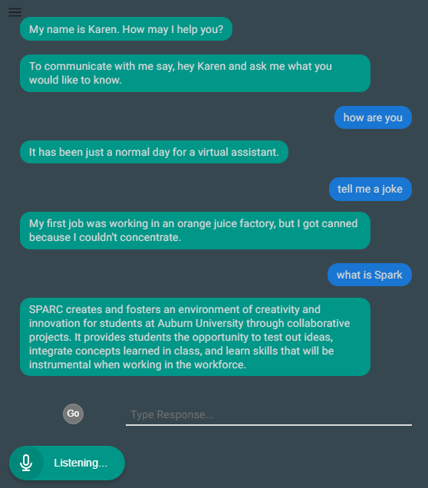
SIDE PROJECT: LAB ASSISTANT
Kinematic
Autonomous
Robot
Enriches
Newcomers
Lab
Information
Support
Tool
Project lead: Arthur Howard
Slack Channel: #projectlabassistant
Goal: create an automated lab assistant.
Is voice controlled.
One day will consist of both a stationary and mobile system.
Can be embedded on the new group chat system Slack.
Programmed in Node.JS (Framework of JavaScript)
Semester Focus
Add functionality
Add database for keeping track of members and equipment
Github Repository:
https://github.com/SPARC-Auburn/Lab-Assistant-IO
Programming Languages
Node.JS
Notes:
6:30

Slide 20
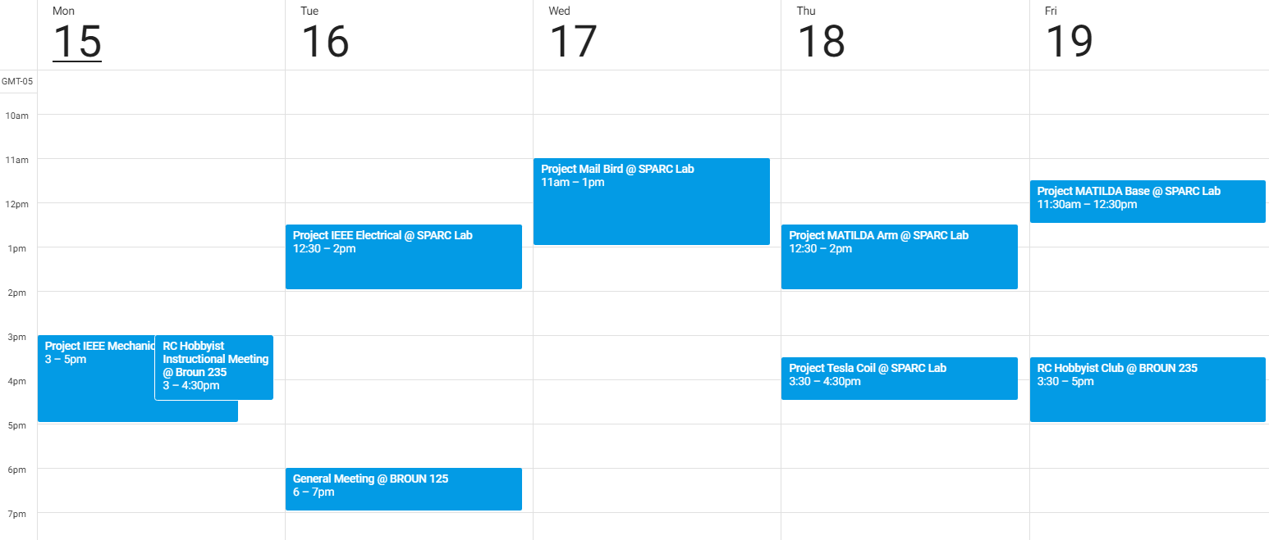
Meeting Schedule

Slide 21
PROJECT IDEAS?
email us at sparc.auburn@gmail.com
or DM Matthew Castleberry @mcberry23 via Slack

Slide 22
Maker Training Session:
Arduino (Part I):
Basic Input and Output

Slide 23
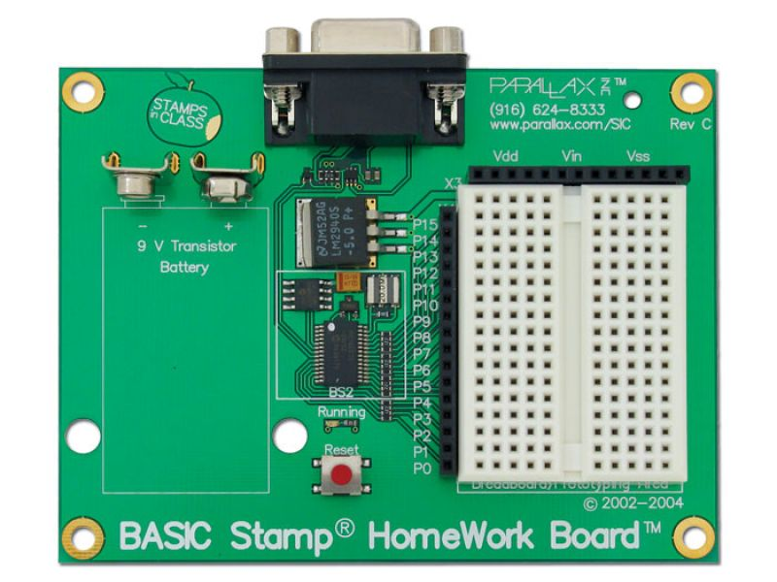

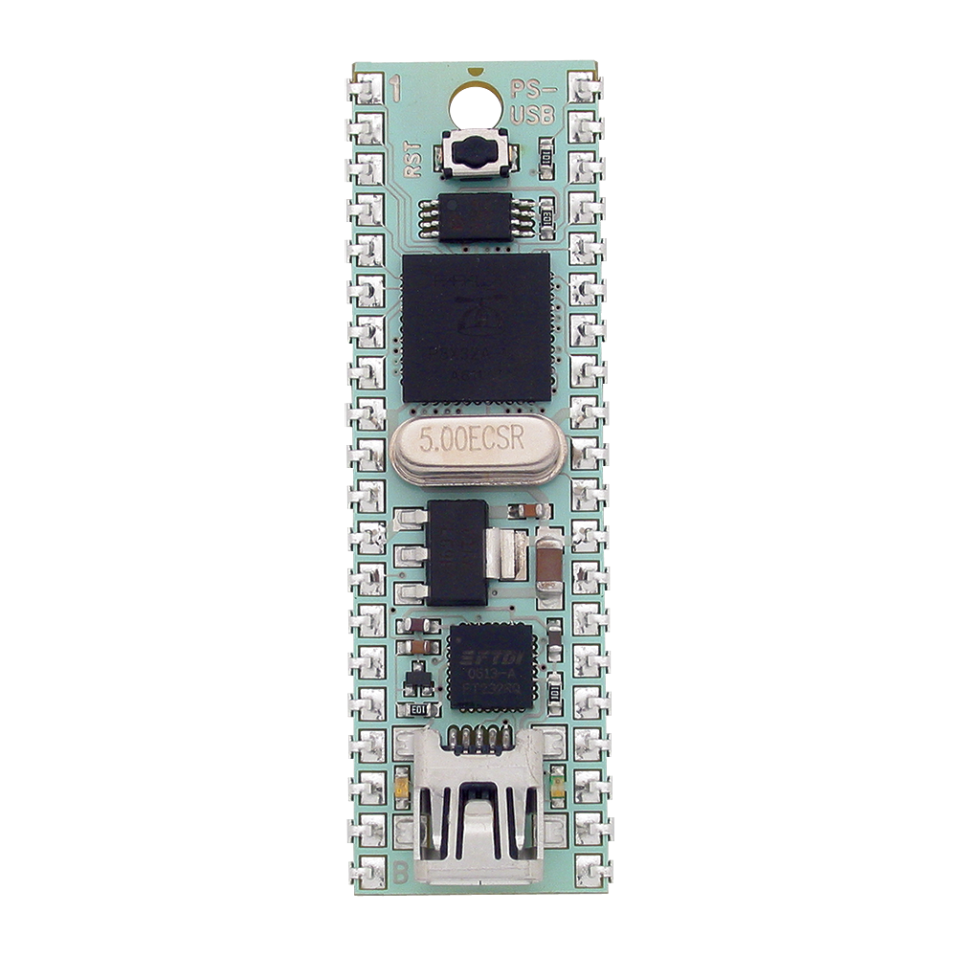
What is a Microcontroller?
A microcontroller is a simple computer on one Integrated Circuit
More economical than traditional computer boards
Are incapable of running a full operating system but can be programmed with simple programs.
Are found in many everyday electronics such as cars, toys, and appliances.
Are relatively easy to use with electrical circuits.
Parallax Basic Stamp
Arduino Uno
Parallax Propeller

Slide 24
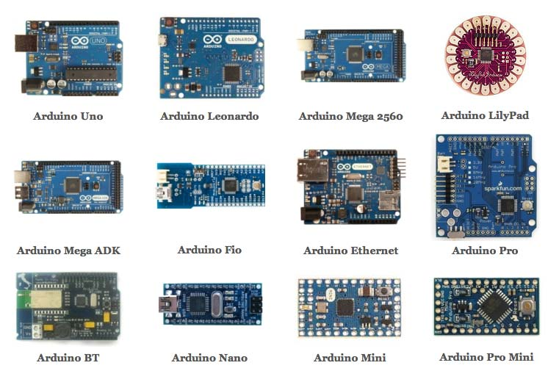
Types of Arduinos

Slide 25

Programming an Arduino
Can be programmed over USB from a computer
Uses the free Arduino IDE software
https://www.arduino.cc/en/Main/Software
Programmed in Arduino C
Has an extensive library with plenty of documentation and examples

Slide 26
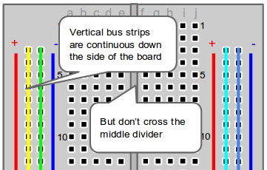
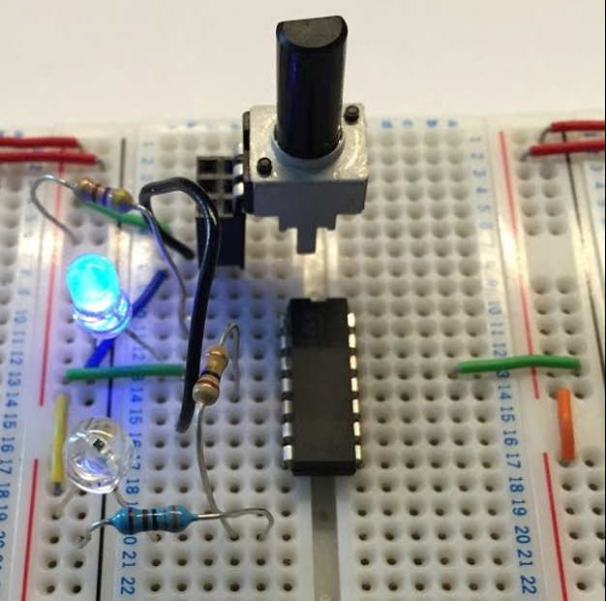
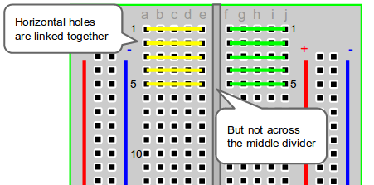
Using a Breadboard

Slide 27
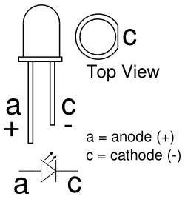
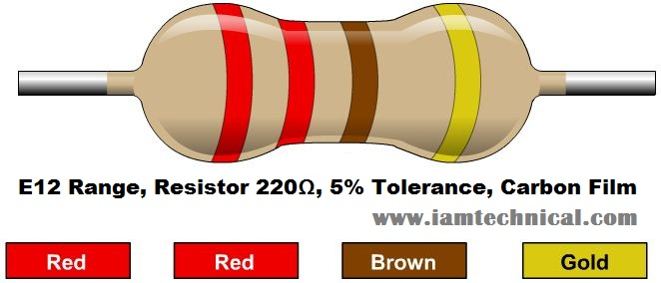

Blink an LED
It is the “Hello World” of using a microcontroller.
Connect the anode of the LED to the digital I/O pin # 13 on Arduino with a 220Ω Resistor in series.
Connect the cathode of the LED to ground (GND)
Useful Commands:
pinMode(pin, OUTPUT/INPUT);
digitalWrite(Pin, HIGH/LOW);
delay(milliseconds);

Slide 28
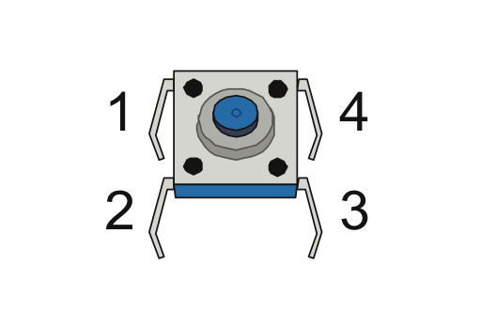
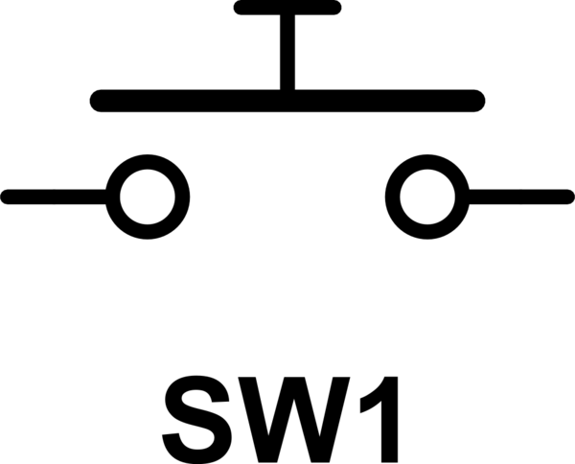
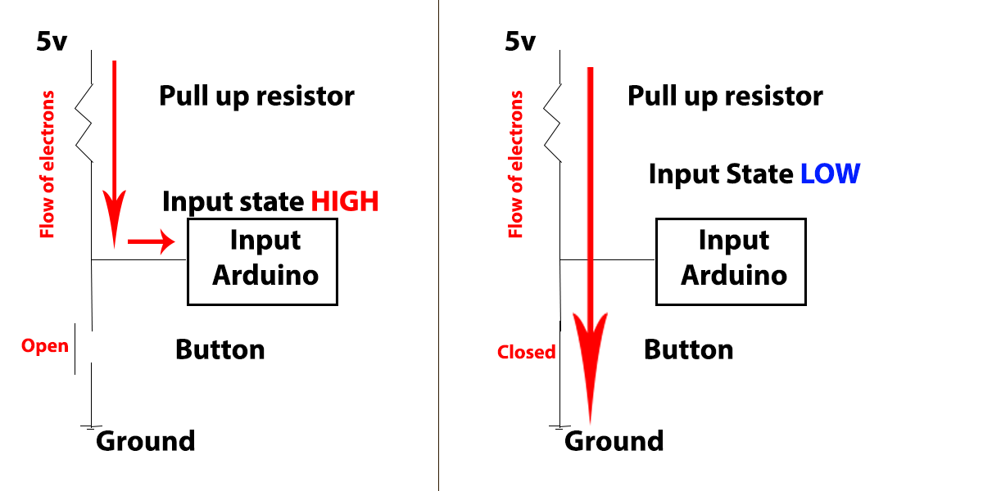
Use a Push Button
Example of Digital Input
Connect a 10kΩ resistor (Brown,Black,Orange) from the 5V to one side of the push button.
Connect IO pin 2 to the same side
Connect the other side to GND
New Commands:
INPUT_PULLUP
Serial.begin(9600);
digitalRead(pin)
Serial.println(output);

Slide 29
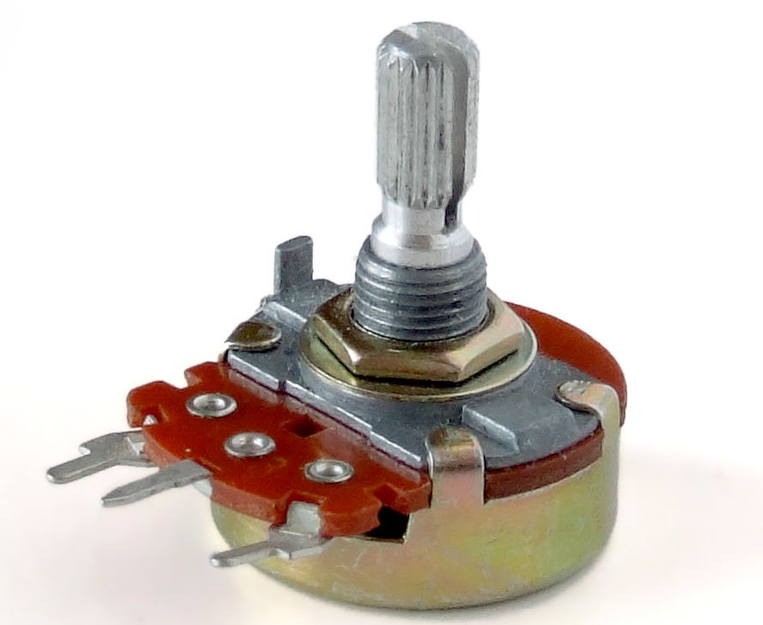
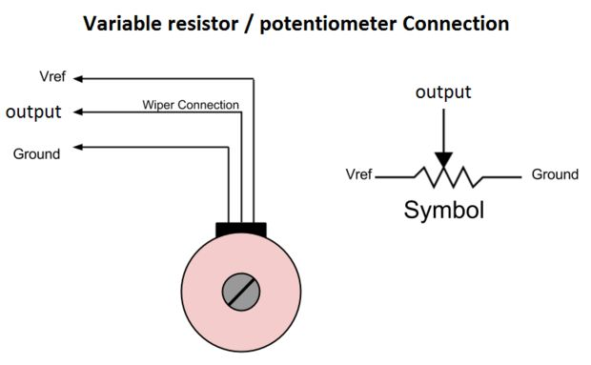
Using a Potentiometer
Example of Analog input
Is a variable Resistor
Is commonly used for volume control knobs
Used for inputting a variable value into the Arduino.
Connect center pin to A0
Connect an outer pin to 5V and the other to GND
New Commands:
analogRead(pin);

Slide 30
QUESTIONS?

